Slide 1
Housing Market Trends in US Metropolitan Areas
Subhankar Ghosh
Zhecheng Sheng
Matthew Hockert
Mohammed Guiga
Group 8

Slide 2
Outline
Project Background
Data Overview
Pipeline
Data Processing
Analysis
Conclusion and Limitations

Slide 3
Data Overview

Slide 4
Data Overview
Economic Data
Understanding the relationship between people and housing
Housing supply and demand
Our project focuses on economic principles and employment
Three primary data sources
Bureau of Labor Statistics (BLS)
Bureau of Economic Analysis (BEA)
Zillow
Level
Metropolitan Statistical Areas (MSA)
Time
Months and years
Notes:
MSA that of a core area containing a substantial population nucleus, together with adjacent communities having a high degree of economic and social integration with that core
Each metropolitan statistical area must have at least one urbanized area of 50,000 or more inhabitants

Slide 5
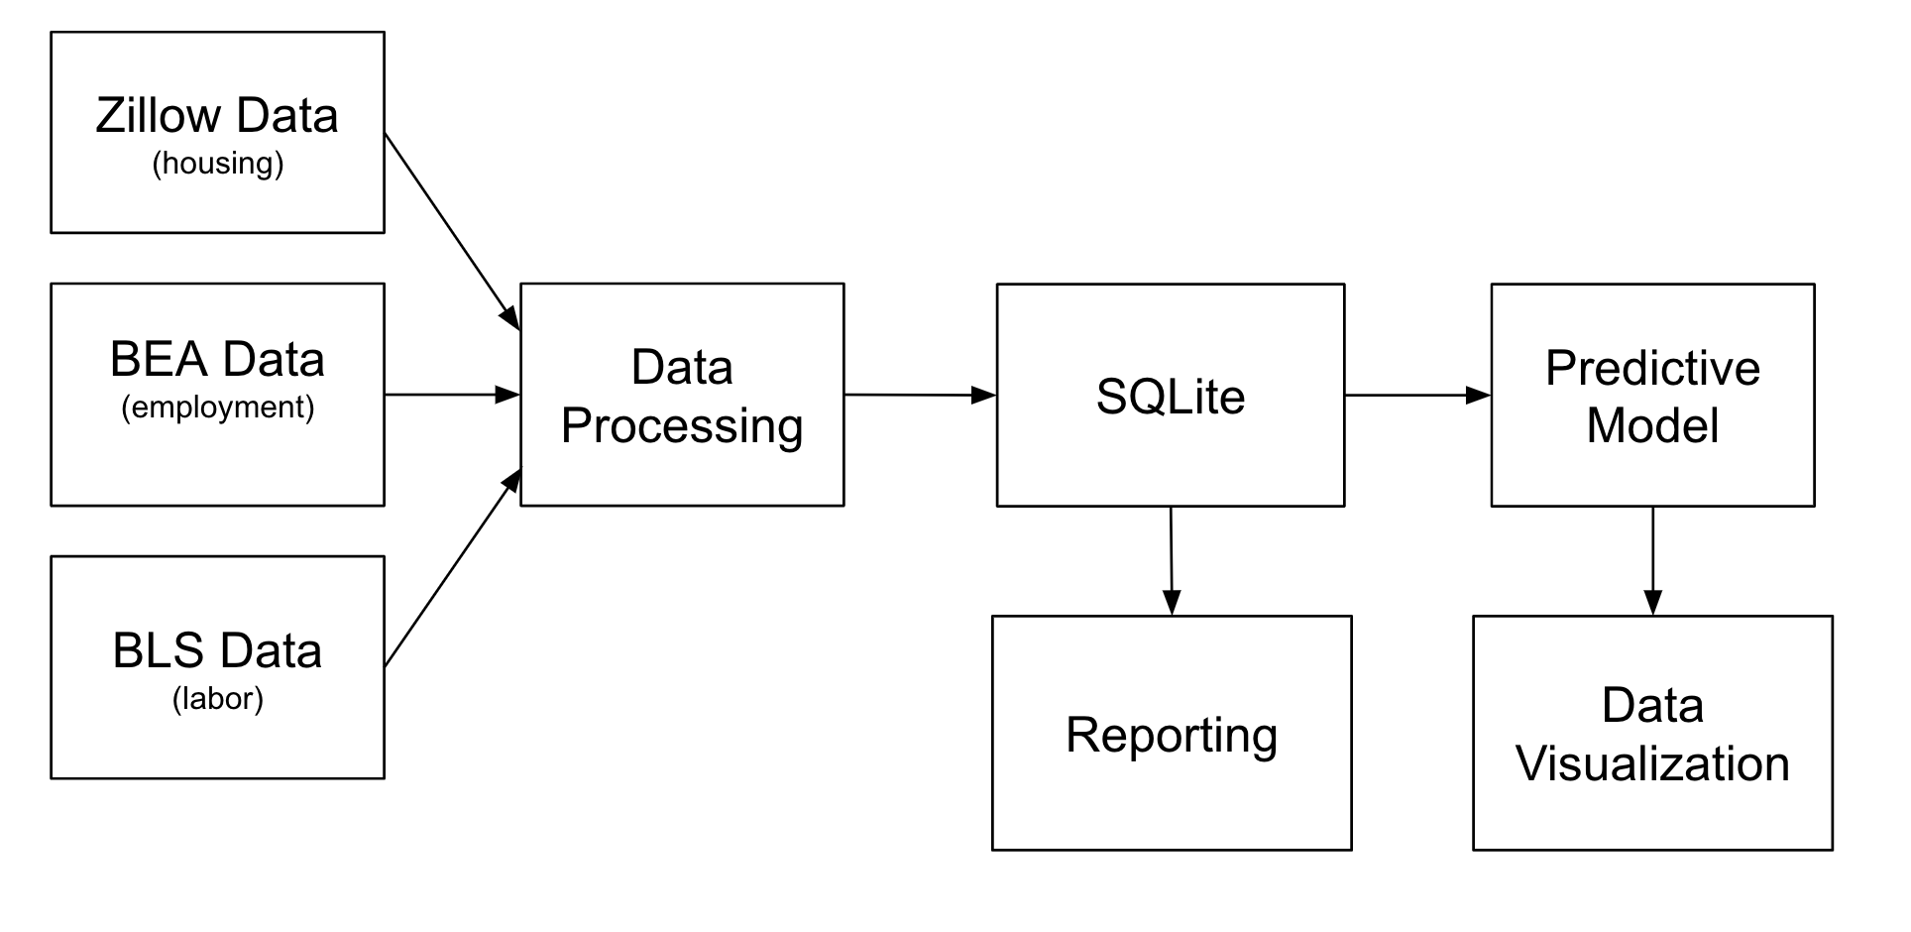
Data Pipeline

Slide 6

Why SQLite?
Provides a SQL interface that can be used within Python (sqlite3)
Integrates seamlessly into our pipeline since the manual ETL is written in Python
Simplest RDBMS solution that meets our project’s requirements

Slide 7
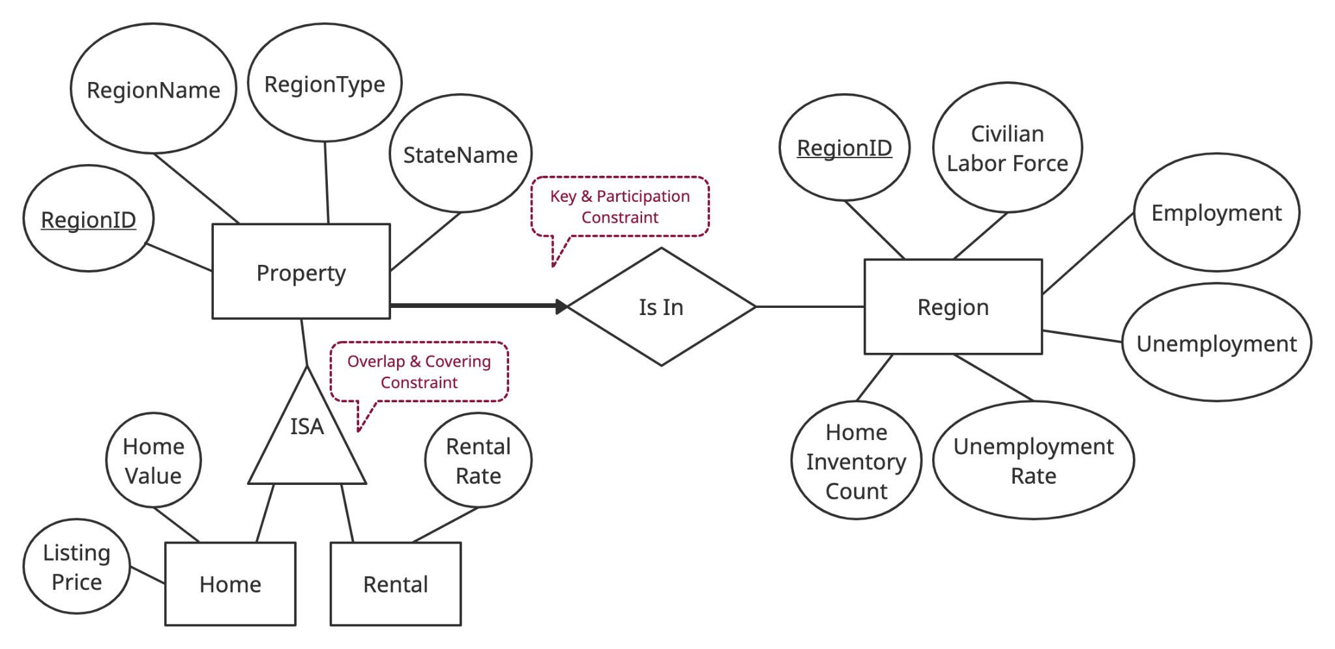
Entity-Relationship Diagram

Slide 8
Data Processing

Slide 9
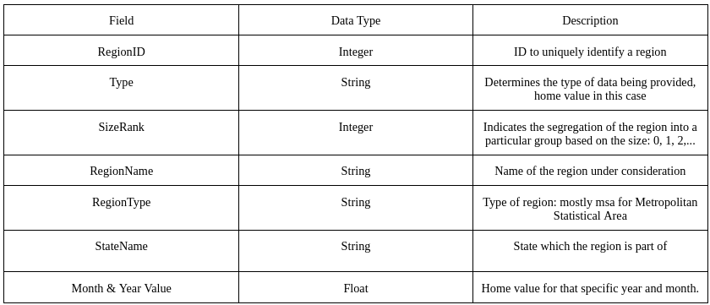
Home Values Schema

Slide 10
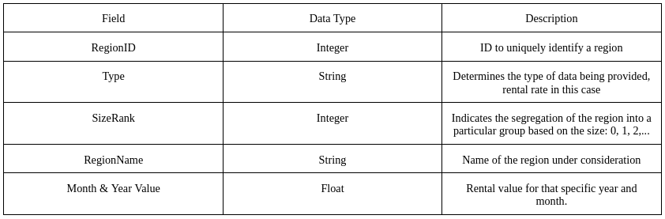
Rental Values Schema

Slide 11
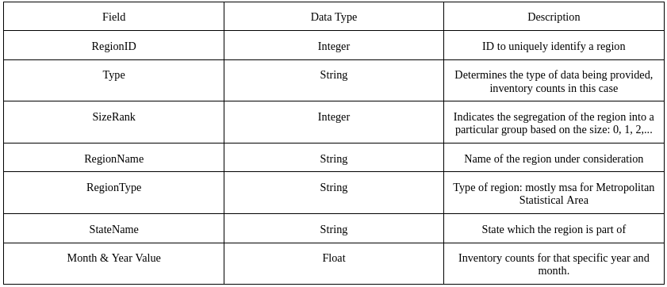
Inventory Schema

Slide 12
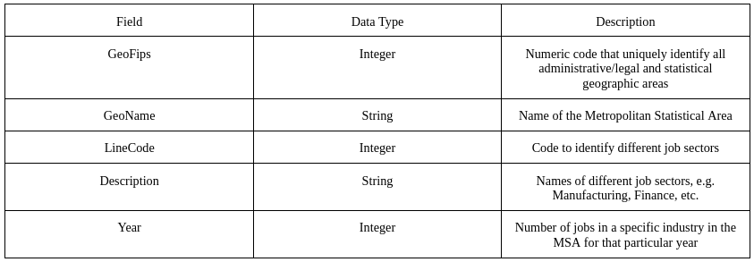
Employment Schema

Slide 13
Data Analysis

Slide 14
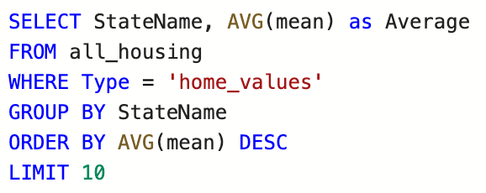
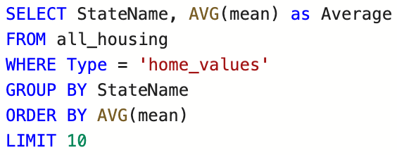
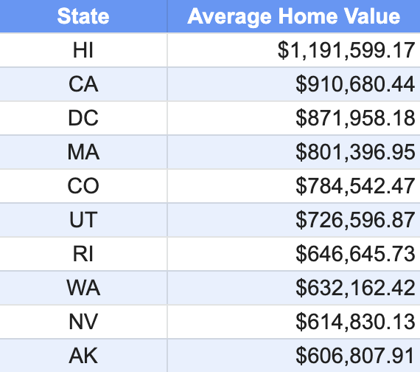
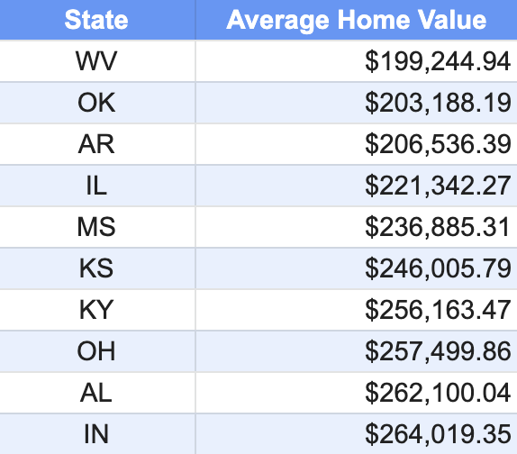
Home Values - top/bottom performers

Slide 15
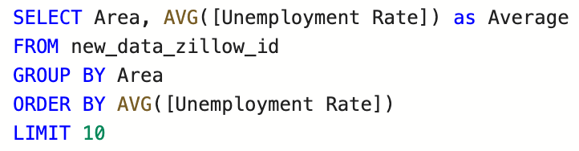
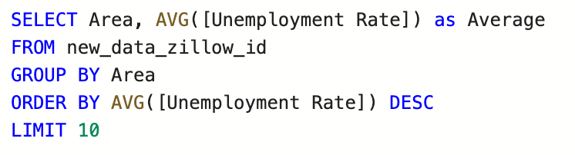
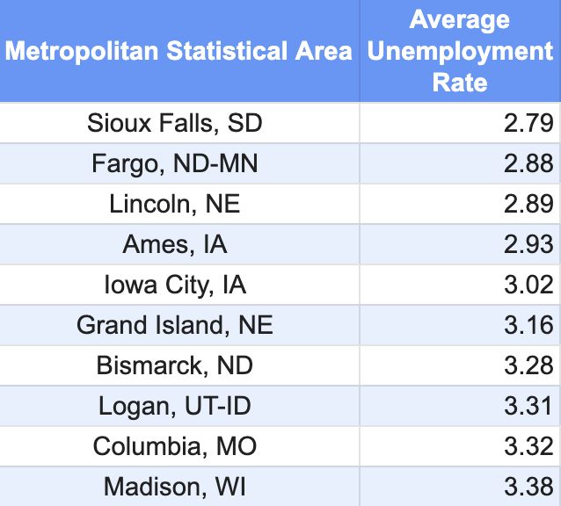
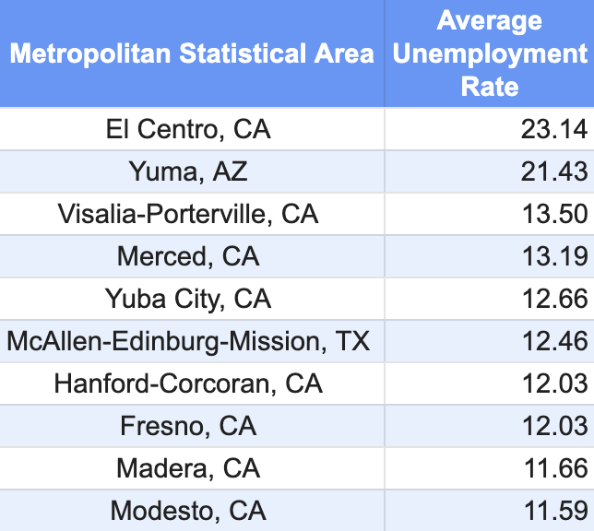
Unemployment Rate - top/bottom performers

Slide 16
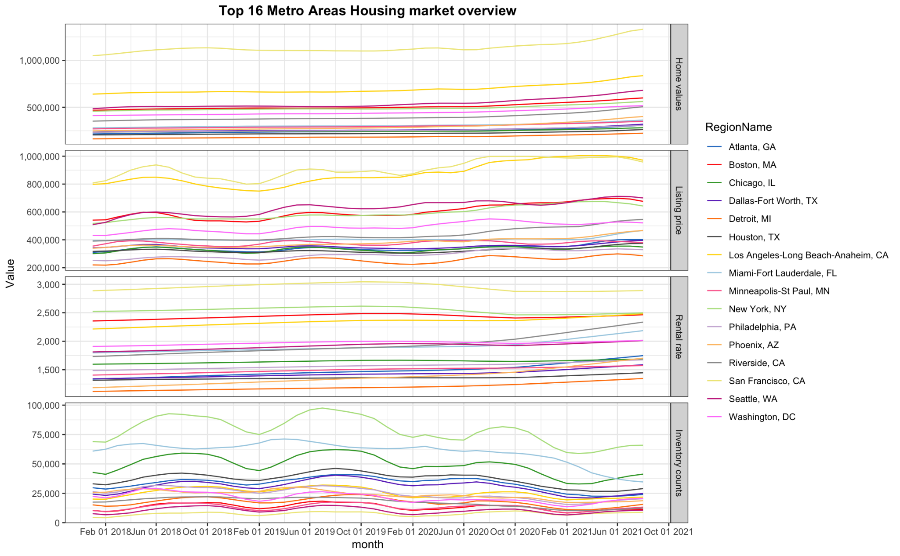
Exploratory analysis of Zillow Data

Slide 17
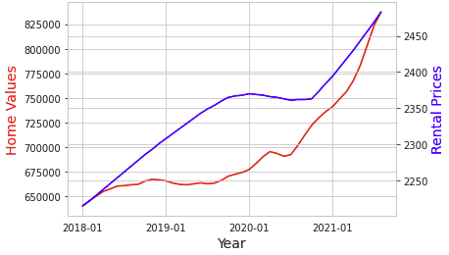
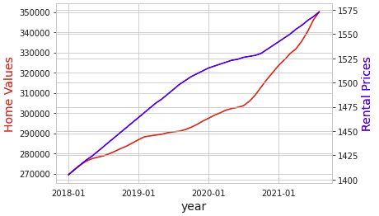
LA & MSP Home and Rental Prices
Los Angeles
MSP

Slide 18
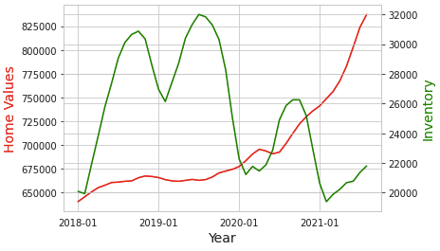
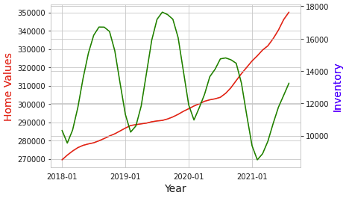
LA & MSP Home Prices and Inventory
Los Angeles
MSP

Slide 19
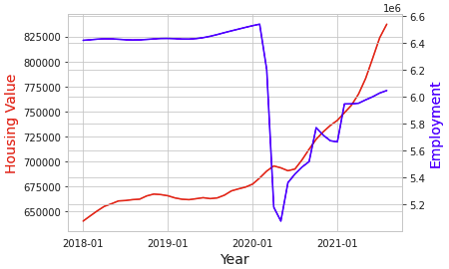
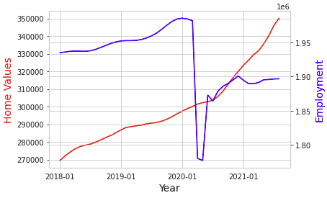
LA & MSP Home Values and Employment
Los Angeles
MSP

Slide 20
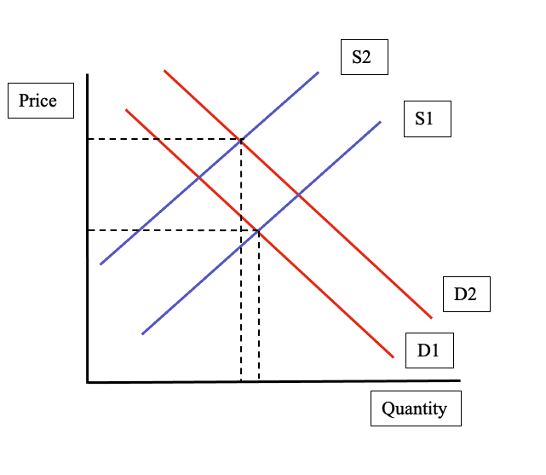
Supply and Demand

Slide 21
Forecasting

Slide 22
Our data is in represented as time series. The time series is a sequence of data points indexed (or listed or graphed) in time order. One natural choice to analyze those time series data for forecasting is ARIMA model.
We try to use this model to forecast the home value in MSP and LA in the next 24 months

Slide 23
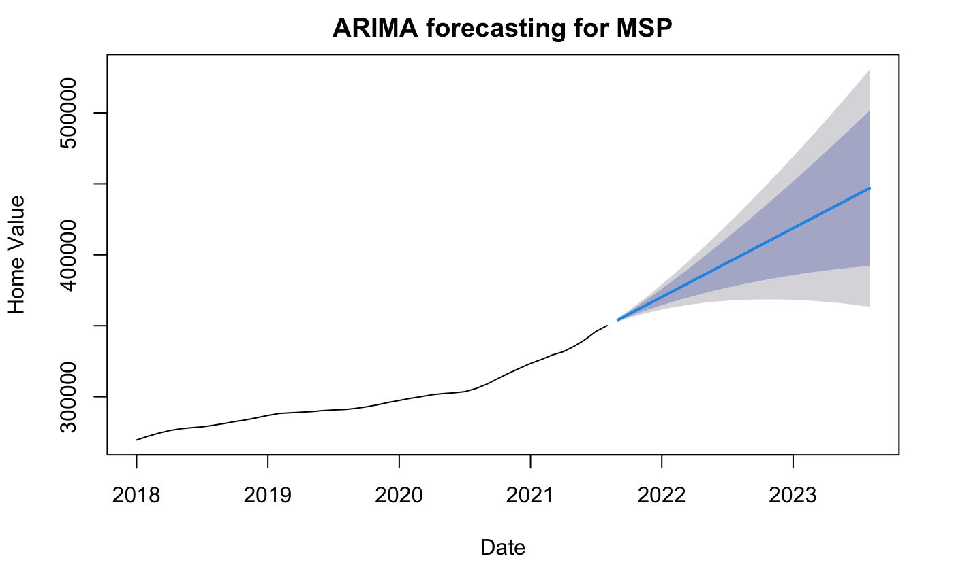
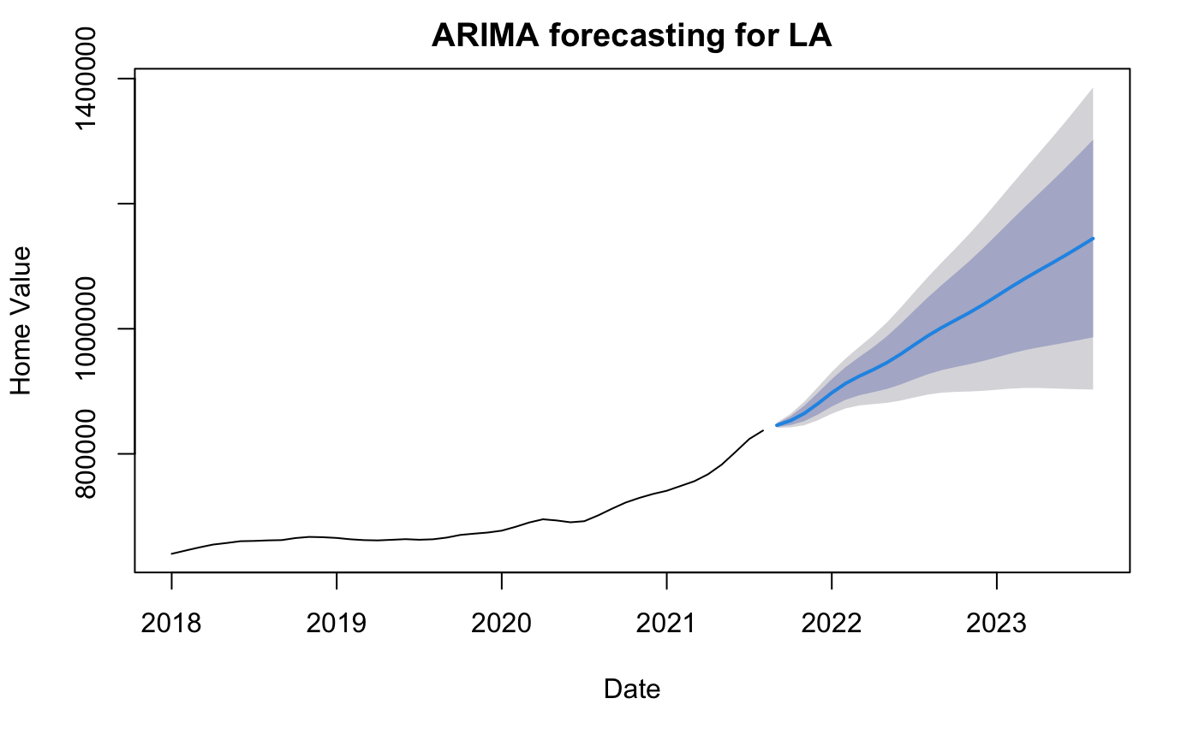
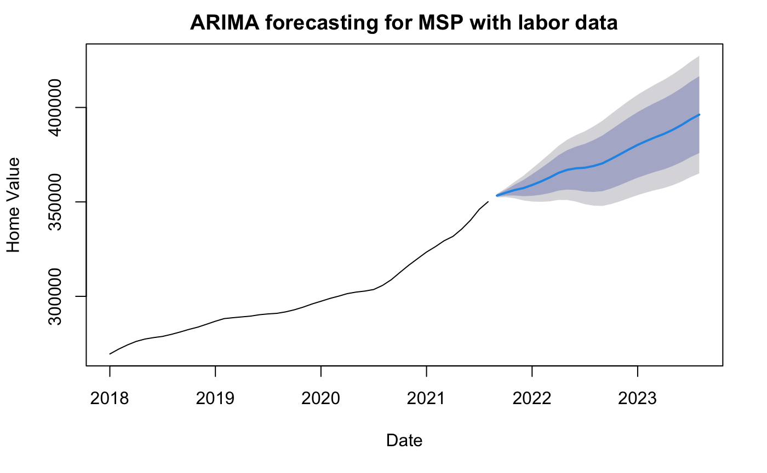
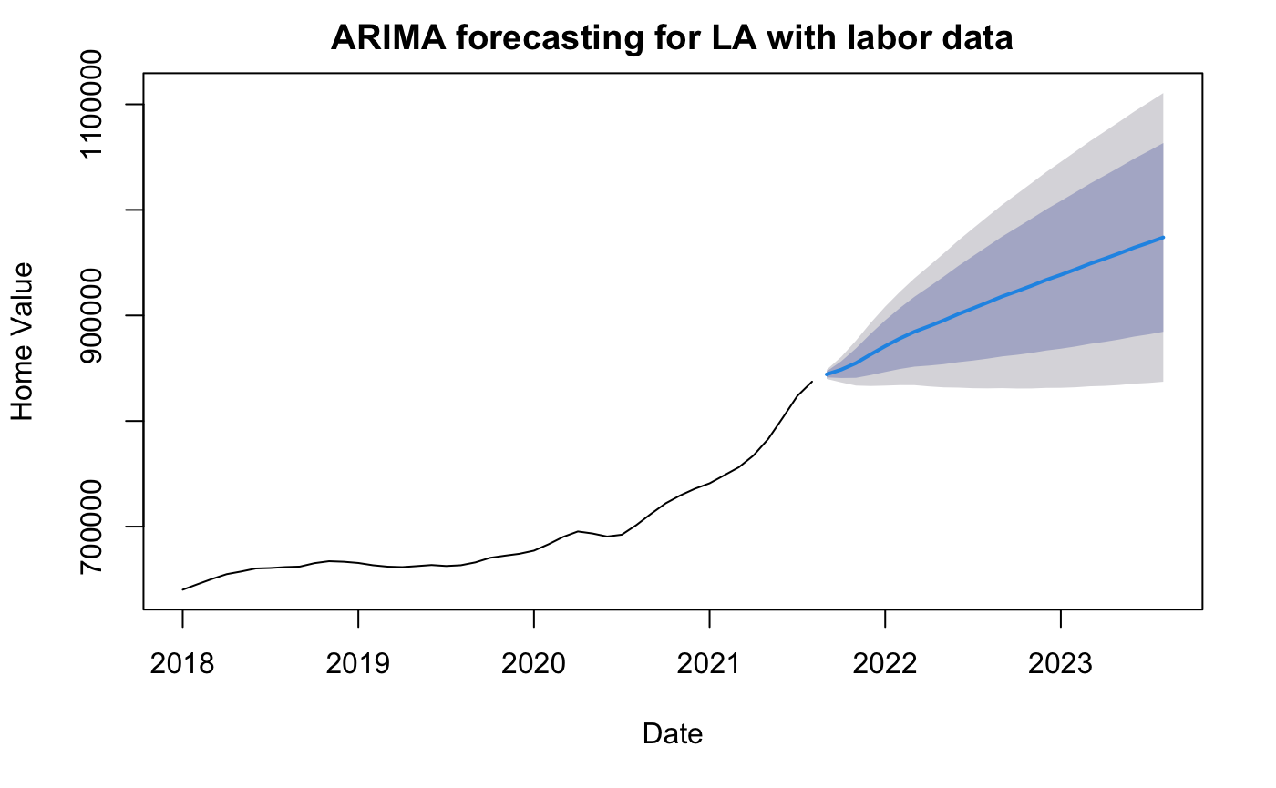
Home value forecasting w/o labor data

Slide 24
Conclusion and Limitations
Housing price will still be increasing despite of the pandemic
Inventory is, generally, correlated with rent and housing prices.
Employment is a decent proxy of population.
After the system was set up we we’re able to answer questions and generate data reports using SQL.

Slide 25
Conclusion and Limitations
Didn’t find a good data source for BEA that is measured in months, otherwise could increase our modeling options.
Could have tried more sophisticated machine learning models for predictions and compare their performance.
Combine geographical information for better insights

